Slide 1
Portfolio Website
Made with js, html and css

Slide 2
The plan:
To make a website that future employers might use to find me or find out more about me.
Make it very DRY and modular through the use of technologies such as SCSS to allow for easy upgrades as we learn more throughout the bootcamp.
I wanted it to be as readable as possible.
Try and minimize clutter and excess elements to the upmost degree.
Will it work?

Slide 3
Home page
The main page should have as little text as possible.
I added a footer bar for accessibility reasons otherwise it would have been even emptier (good thing?... dunno)
There should be a slideshow with links to my work media.
Used a geometric sans serif font to make it look as clean as possible.
Home page should essentially be a hub of 0 information and just links.

Slide 4
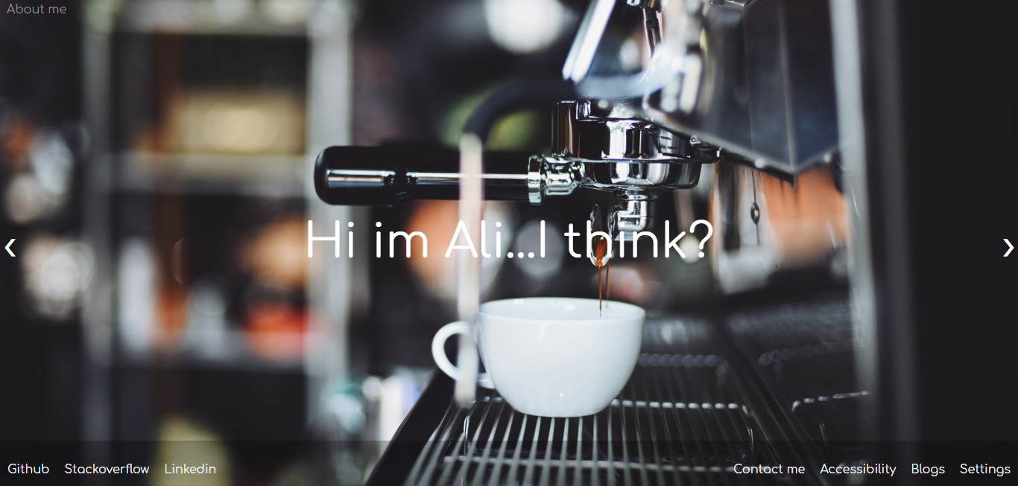

Slide 5
About me
Again going on with the minimalist theme with clean and modern colours.
Not much written there because my skills don’t exist.
I should have animated the columns entering in the page.

Slide 6
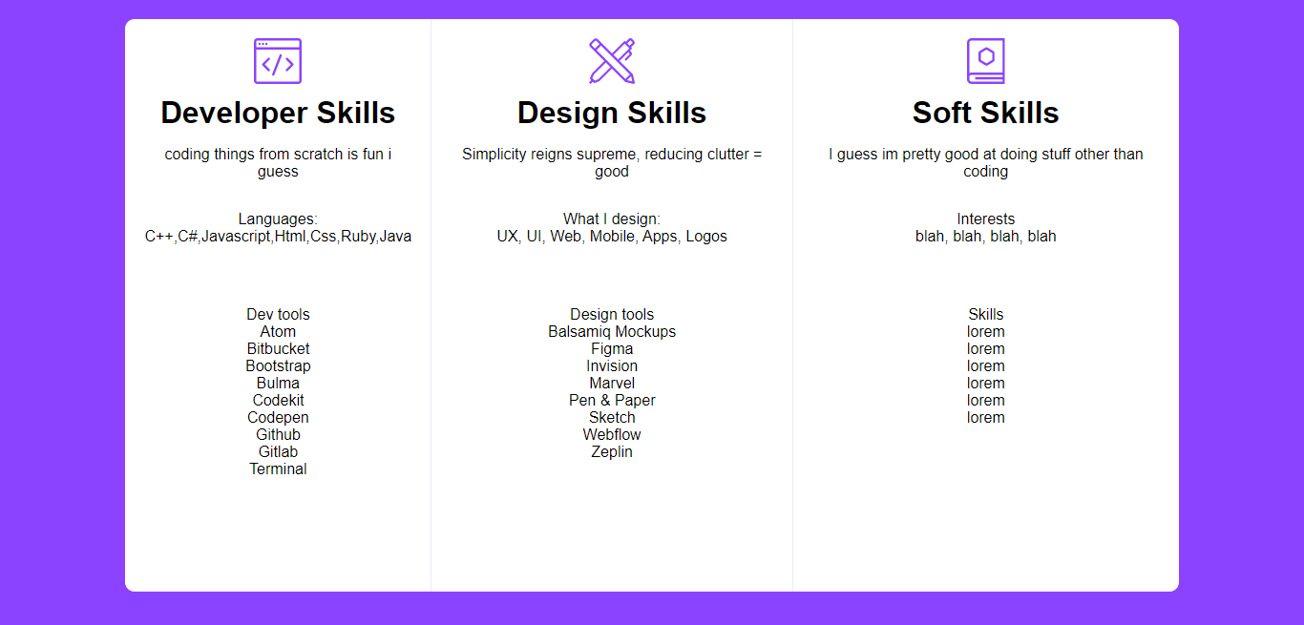

Slide 7
Accessibility Page
Basically a snippet saying that the website complies with A level WCAG(2.0)
It did… but not anymore luckily for me.

Slide 8
Contact me
Form area with 3 different required fields.
Animated entry into the screen
The form doesn’t actually do anything for the moment.

Slide 9
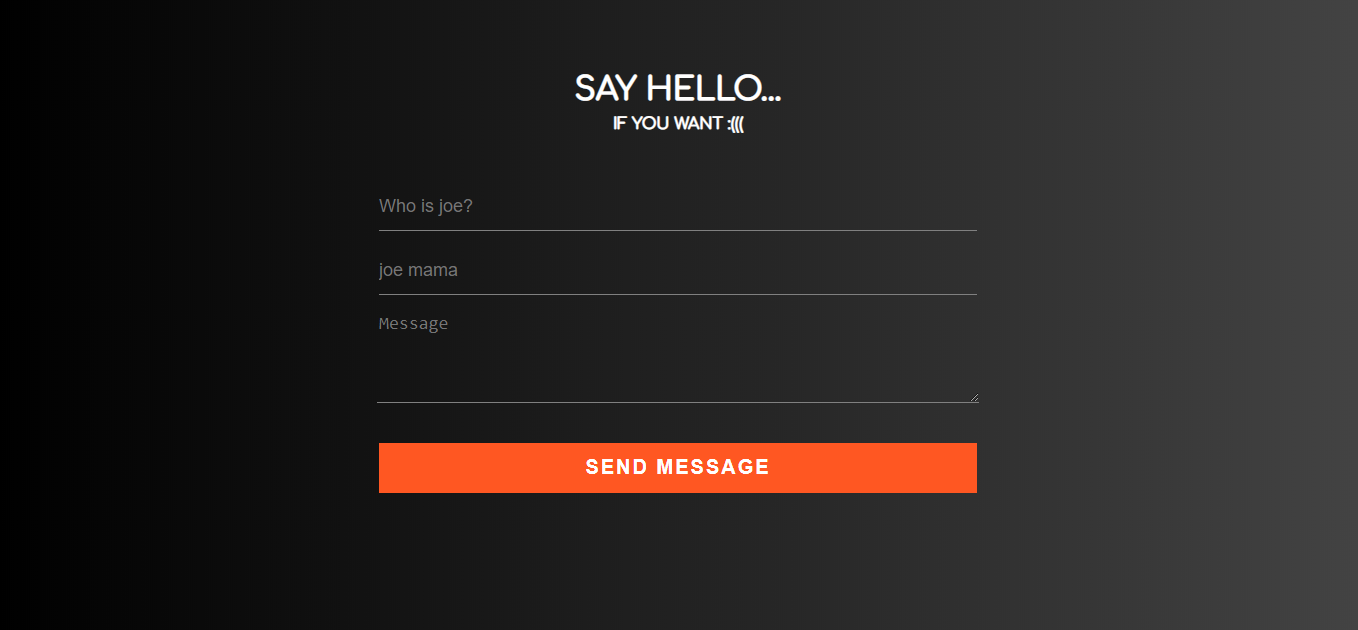

Slide 10
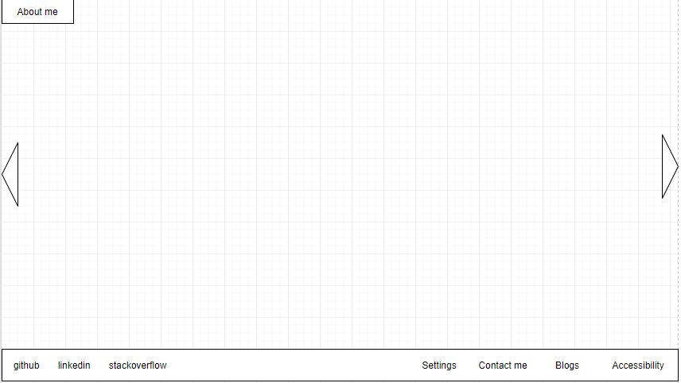

Slide 11
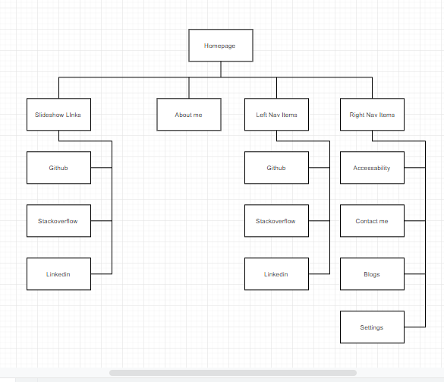

Slide 12
Most fun areas to work on:

Slide 13
Difficulties
All of it.
Nothing works.
Ever.
Html+css=regret and sadness
Actually, JavaScript isn’t bad.

